Slide 1



Salary Predictions of Data Professions
Mentorness internship program

Slide 2
Problem Statement:
Salaries in the field of data professions vary widely based on factors such as experience, job role, and performance.
Accurately predicting salaries for data professionals is essential for both job seekers and
employers.

Slide 3


Dataset Overview:
The dataset contains the following columns:
➢ `FIRST NAME`: First name
➢ `LAST NAME`: Last name
➢ `SEX`: Gender
➢ `DOJ`: Date of joining the company
➢ `CURRENT DATE`: Current date of data
➢ `DESIGNATION`: Job role/designation
➢ `AGE`: Age
➢ `SALARY`: Target variable, the salary of the data professional
➢ `UNIT`: Business unit or department
➢ `LEAVES USED`: Number of leaves used
➢ `LEAVES REMAINING`: Number of leaves remaining
➢ `RATINGS`: Ratings or performance ratings
➢ `PAST EXP`: Past work experience

Slide 4
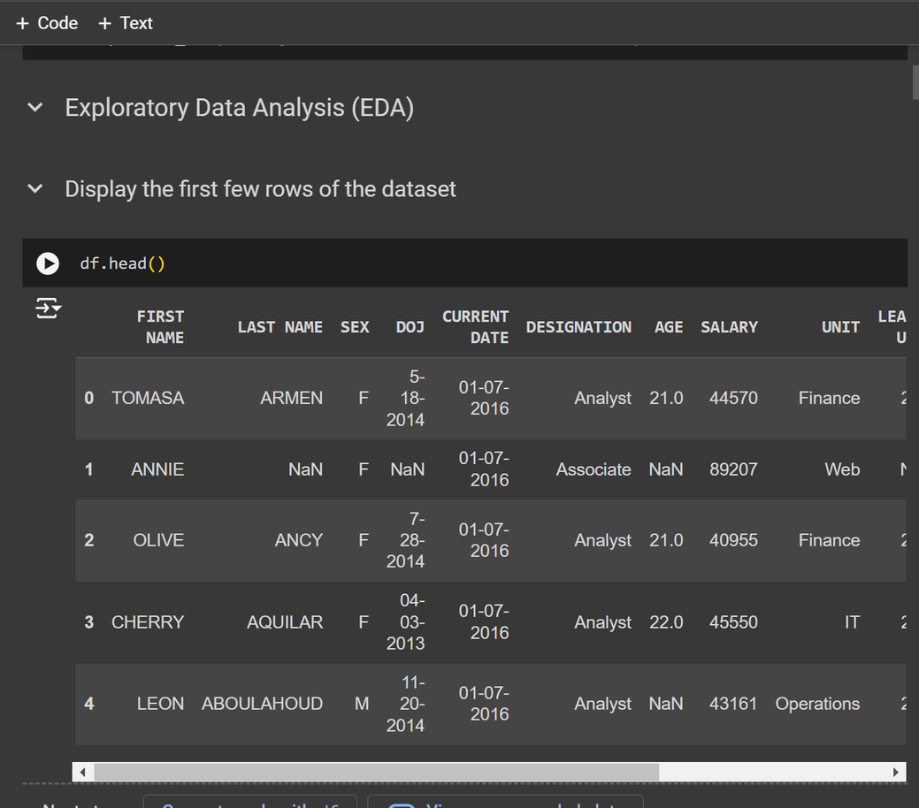
Project tasks
Exploratory Data Analysis (EDA):
Dive into the dataset, conduct comprehensive EDA, and unveil
valuable insights about data professionals' salaries. EDA will involve data visualization, summary, statistics, and identifying patterns in the data.

Slide 5
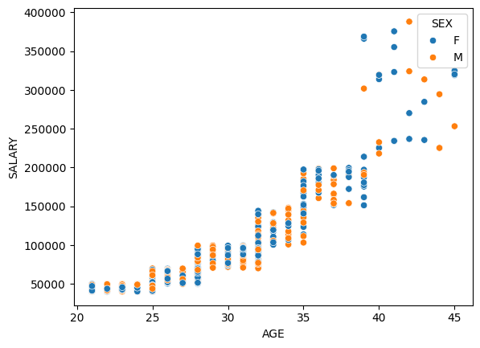
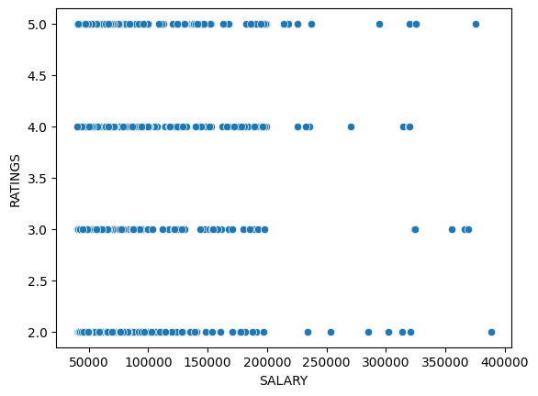
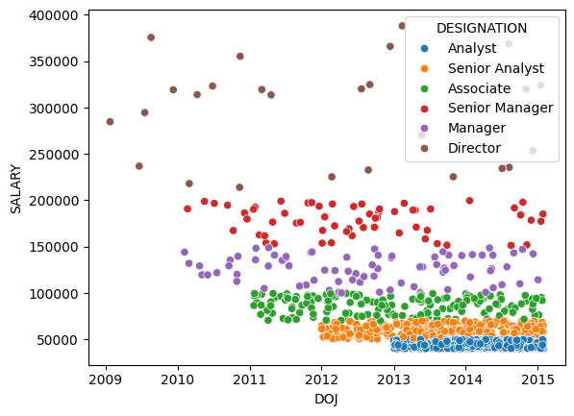
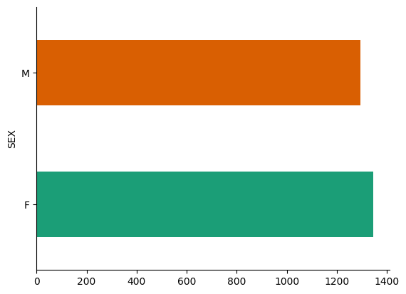

Slide 6
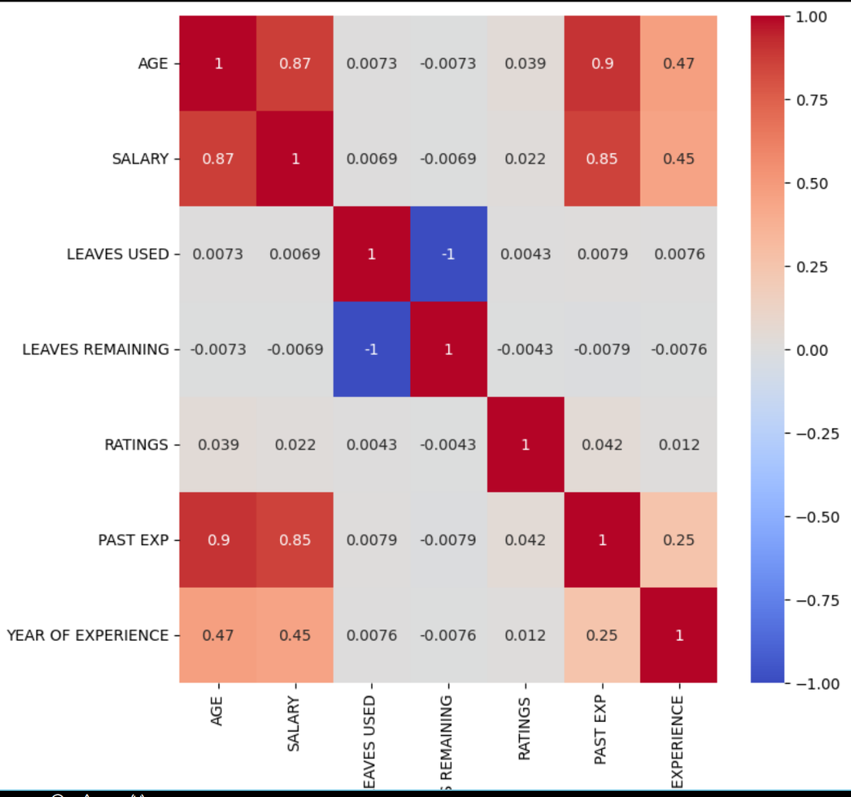
2. Feature Engineering:
Create new features or transform existing ones that can provide additional insights or improve model performance. Feature engineering might involve deriving features related to experience, job role, and performance.

Slide 7
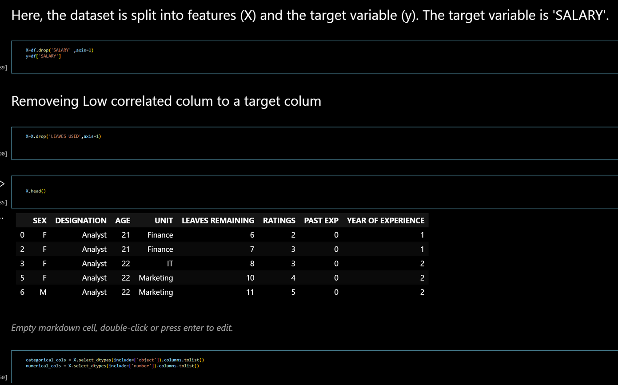
3. Data Preprocessing:
Prepare the data for model training. This includes handling missing values, encoding categorical variables, and scaling or normalizing features as needed.

Slide 8
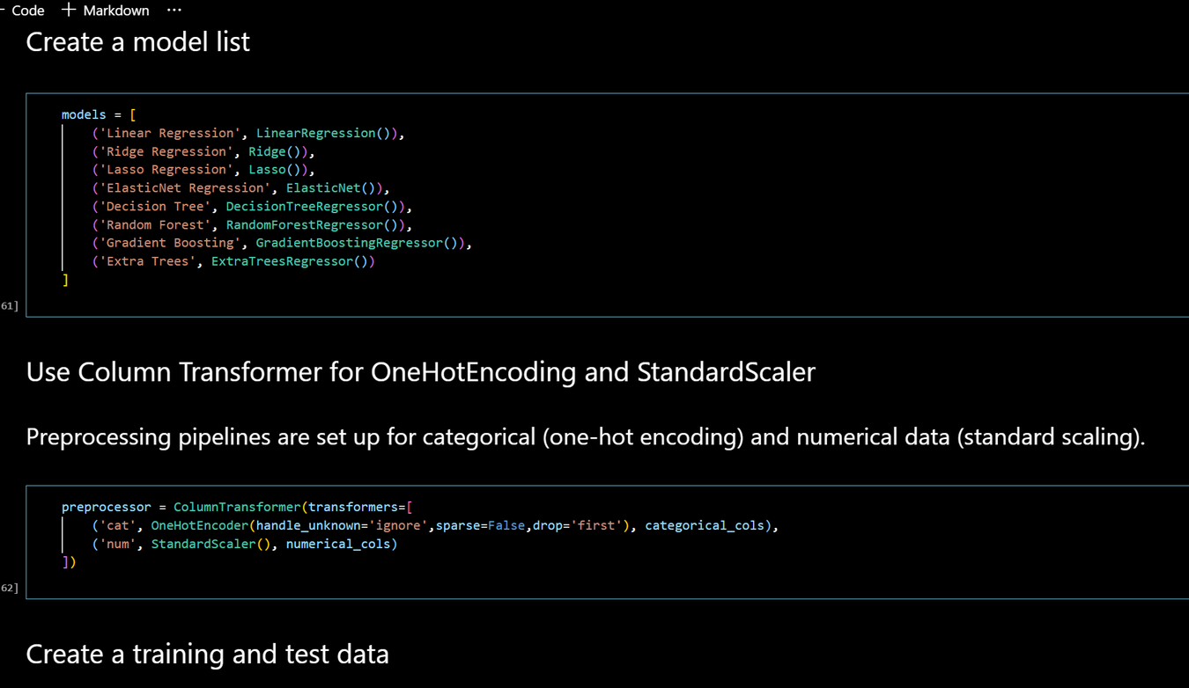
4. Machine Learning Model Development:
Train various machine learning regression models to predict salaries. Experiment with different algorithms such as linear regression, decision trees, random forests, and gradient boosting to find the best-performing model.

Slide 9
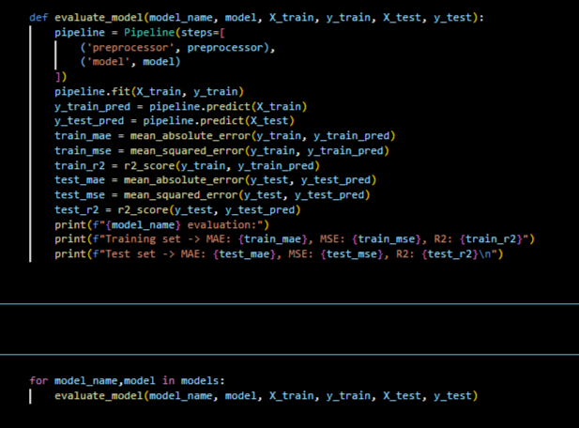
5. Model Evaluation:
Assess the performance of your models using appropriate evaluation metrics like Mean Absolute Error (MAE), Mean Squared Error (MSE), Root Mean Squared Error (RMSE), and R-squared (R2) score. Identify the model that provides the most accurate salary predictions.

Slide 10
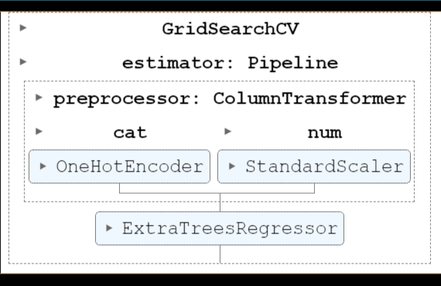
6. ML Pipelines and Model Deployment:
Create ML Pipelines to streamline the end-to-end machine learning process, from data preprocessing to model training. Additionally, deploy a model that can generate predictions for unseen data.

Slide 11
Conclusion:
Based on your findings and insights from the model we provide actionable
recommendations. These recommendations are related to factors influencing salaries and potential
strategies for improving earnings in data professions.

Slide 12
Thank you
Lokesh Pratap Singh

